Slide 1
Knossos, Crete
By: Spencer Harrington

Slide 2
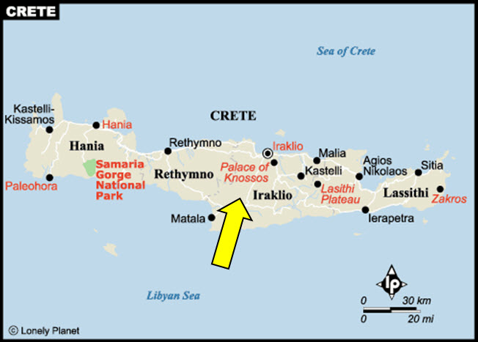
Where is it?
Location: Heraklion, Crete, Greece
Region: North Central Coast, 5 km (3.1 mi) Southeast of Heraklion

Slide 3
About the City
It is the largest Bronze age archaeological site on Crete
Was settled as early as the Neolithic Period “New Stone Age” which was approx. 12,000 years ago
Famously known for Knossos Palace: used as a political and ceremonial center of Minoan Civilization
Under Mino’s rule, the city flourished with help of maritime trade and commerce with other cities on Crete such as Phaestos and Mallia.

Slide 4
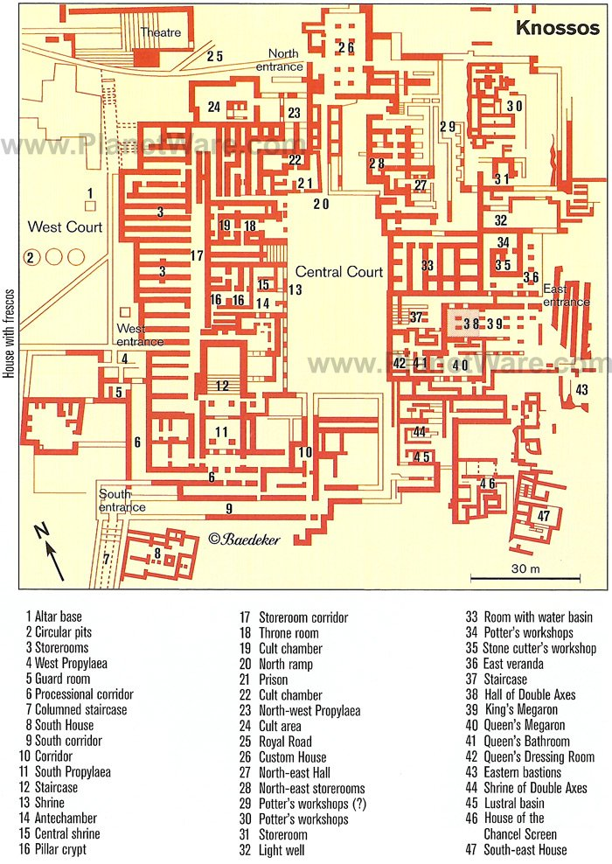

Slide 5
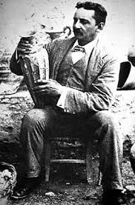
Discovery of Knossos
Excavation was started by Minos Kalokairinos in 1878.
Was later taken over by Sir Arthur Evans in 1900 and finished in 1931.
Found numerous of clay tablets written in Linear A and B.
Evans came to the island because of his interest in ancient coins and seal stones.
Sir Arthur Evans at Knossos

Slide 6
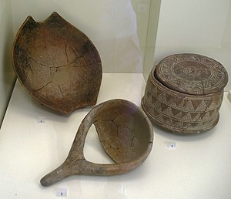
Pottery dating to Early Neolithic (6,500-5,800 BCE)

Slide 7
The Palaces
There were two palaces built.
First palace was around 1900 BC destroyed in 1700 BC
Was massive and very thick walls
Records show that the Crete was not unified. Walls acted as safety.
Second Palace and Complex Second palace Built immediately
Second Complex/Palace is in ruins today

Slide 8
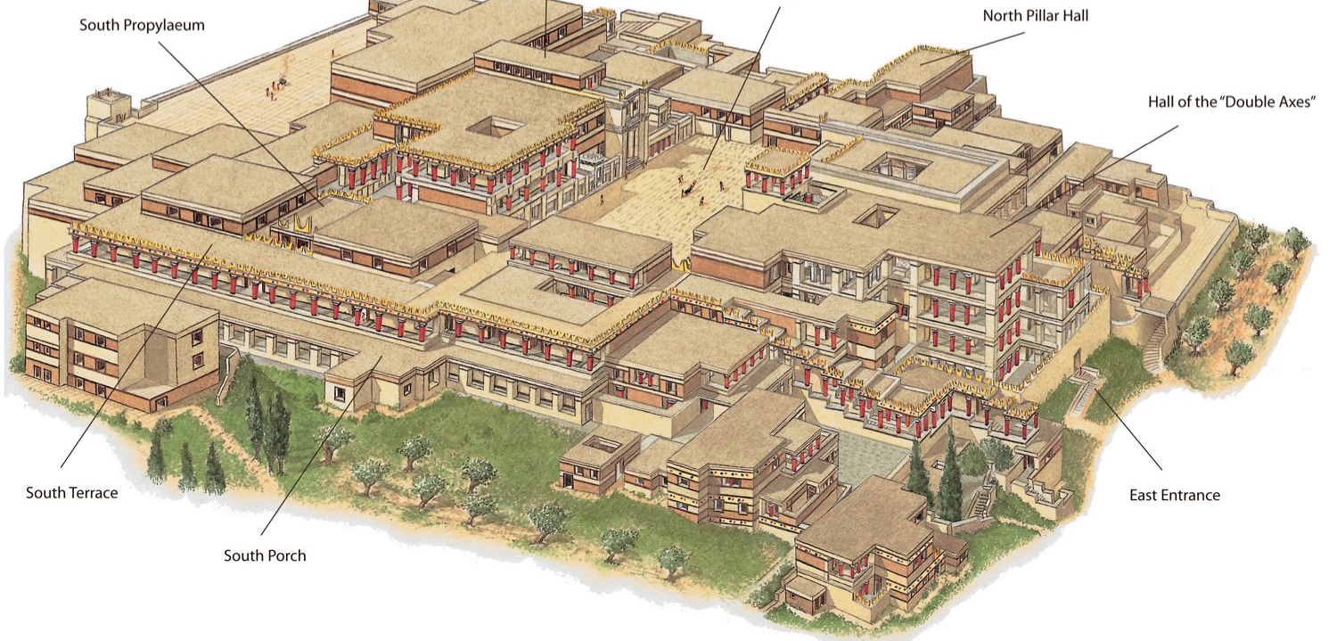
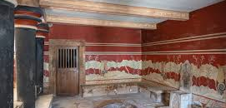
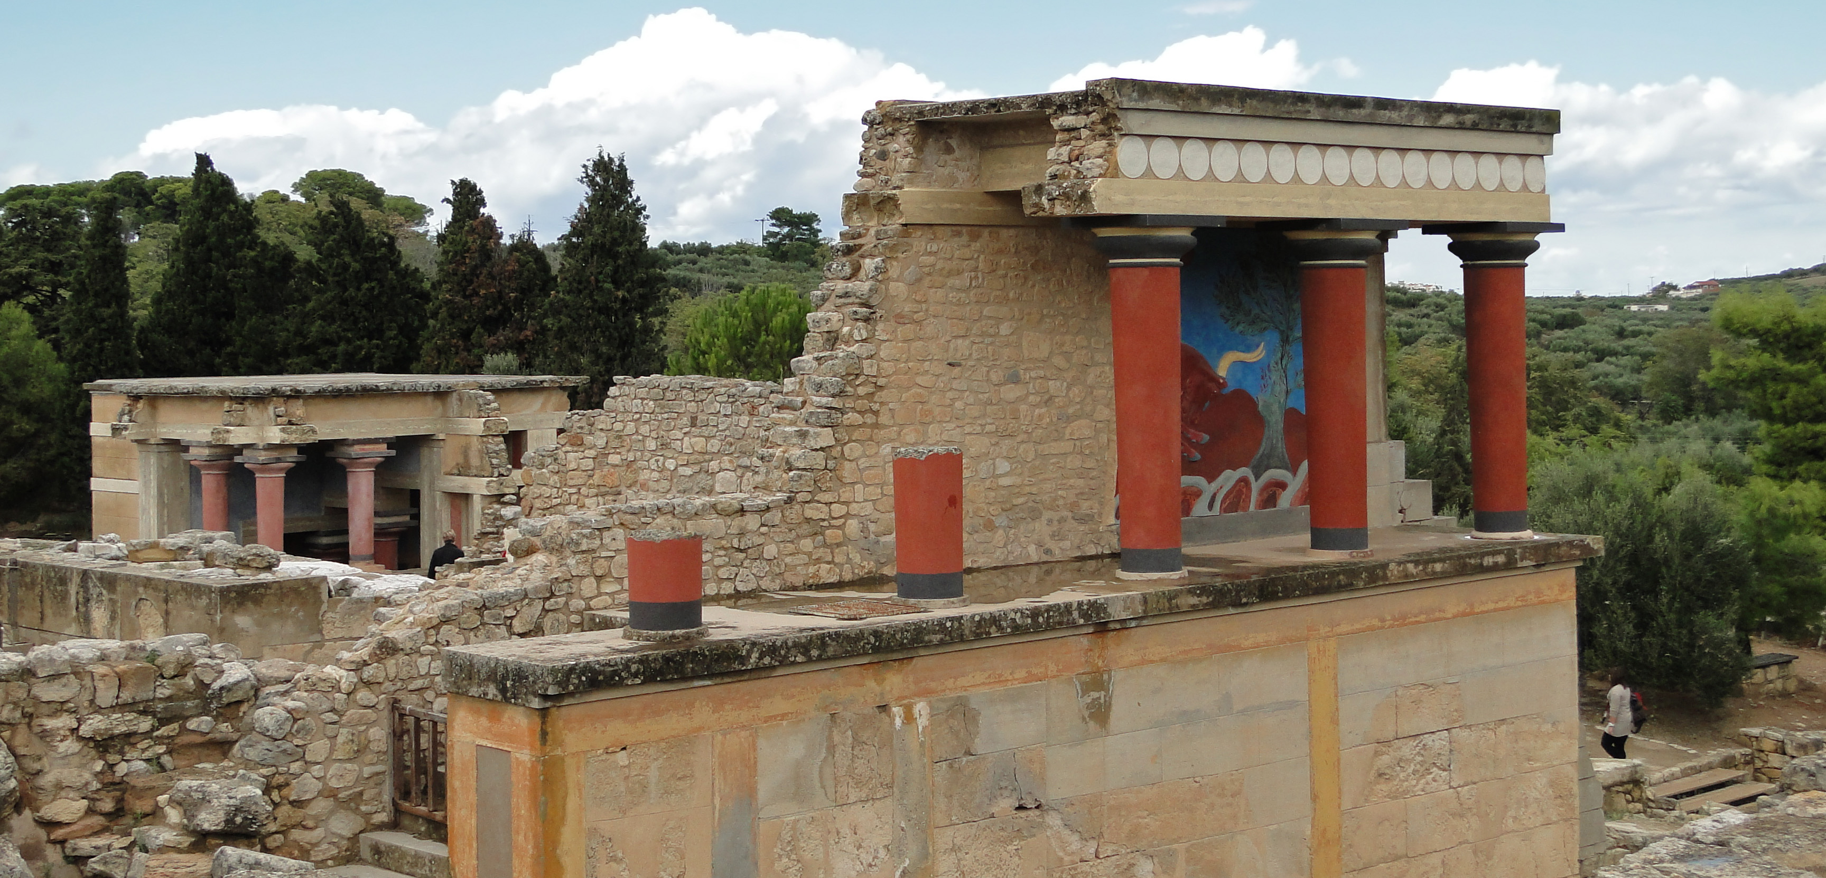
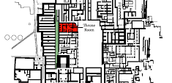

Slide 9
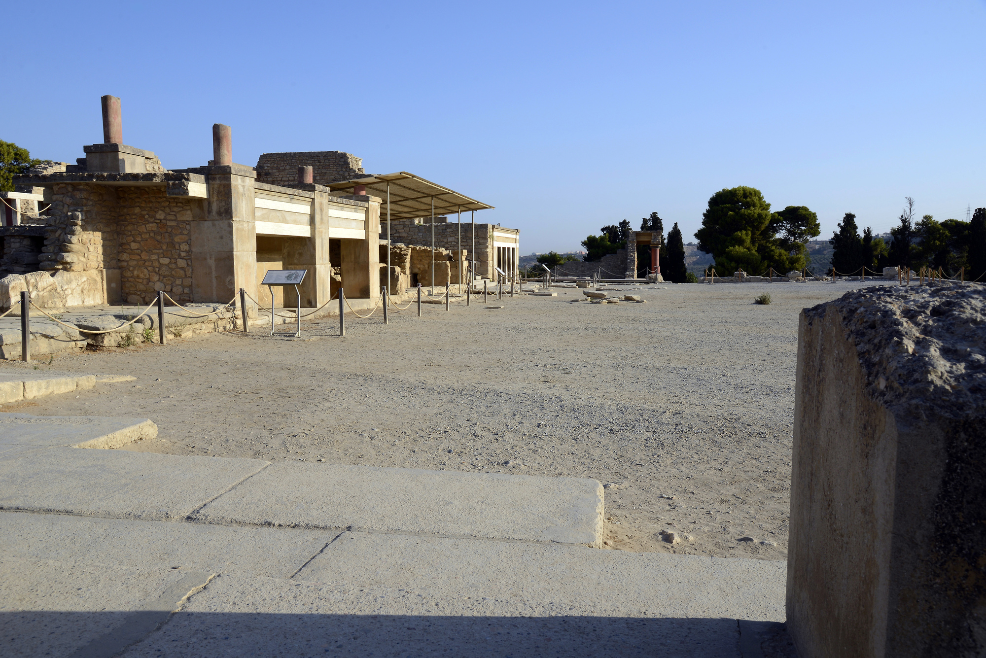

Slide 10
The End of Knossos
Most of the civilizations on Crete were destroyed by earthquakes and volcanic eruptions over time
The Myceneans invaded 1450 BCE
There has been evidence of the Mycenean’s rebuilt the second palace and used it their capital until 1375 BCE
Centuries, Knossos was considered a myth until its discovery.

Slide 11
Bibliography
Chris Scarre, and Rebecca Stefoff. The Palace of Minos at Knossos. Oxford University Press, 2003. EBSCOhost, search.ebscohost.com/login.aspx?direct=true&db=e000xna&AN=144885&site=eds-live&scope=site.
Evans, Sir Arthur, www.brown.edu/Departments/Joukowsky_Institute/courses/greekpast/4869.html.
Mark, Joshua J. “Knossos.” Ancient History Encyclopedia, Ancient History Encyclopedia, 17 Feb. 2021, www.ancient.eu/knossos/.
Google Images

